Slide 1
Linux Network Configuration
Linux System Administration
/etc/resolv.conf Tells the kernel which name server should be queried when a program asks to "resolve" an IP Address.
nameserver 172.31.1.1
search cc.iitk.ac.in iitk.ac.in
/etc/sysconfig/network Indicates networking is enabled (NETWORKING=yes) and provides information on hostname, gateway and nis domain.
NETWORKING=yes
HOSTNAME=webhome.cc.iitk.ac.in
NISDOMAIN=cc
GATEWAY=172.31.1.250

Slide 2
Linux Network Configuration
Linux System Administration
/etc/sysconfig/network-scripts/ifcfg-eth0 Network configurations like boot protocol (static/dhcp), ip address, netmask, network address, broadcast address etc.
DEVICE=eth0
ONBOOT=yes
BOOTPROTO=static
IPADDR=172.31.1.40
NETMASK=255.255.0.0
BROADCAST=172.31.255.255
NETWORK=172.31.0.0
GATEWAY=172.31.1.250

Slide 3
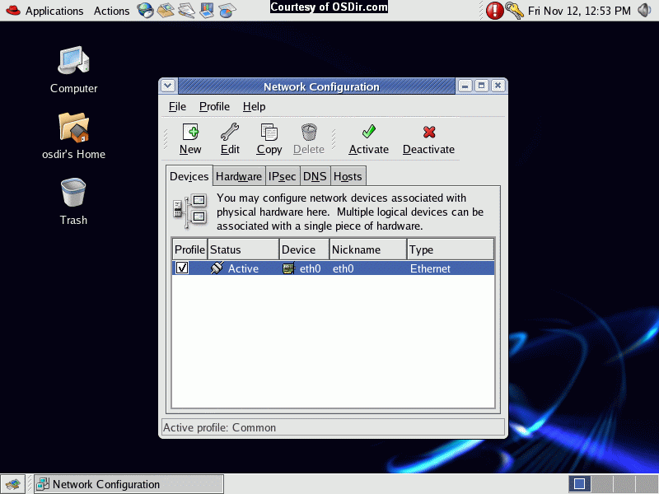

Slide 4
Scheduling Jobs: Cron
Linux System Administration
Cron is a program that enables you to execute a command, or a script with a sequence of commands, at a specified date, time or at set intervals.
Add the job script in /etc/cron.hourly or /etc/cron.daily or /etc/cron.weekly or /etc/cron.monthly to schedule a job

Slide 5
Scheduling Jobs: Cron
Linux System Administration
Make an entry in /etc/crontab file to schedule a job (crontab -e) the format is
* * * * * command_to_execute
each star denotes Minute Hour Day_of_Month Month Day_of_Week
Minute = Minute of the hour, 00 to 59. * Will indicate every minute
Hour = Hour of the day in 24-hour format, 00 to 23. * Will indicate every hour
Day = Day of the month, 1 to 31. * Will indicate every day
Month = Month of the year, 1 to 12. * Will indicate every month
Day = Day of the week, 3 chars - sun, mon, tue, or numeric (0=sun, 1=mon etc).... * Will indicate every day
Task = The command you want to execute

Slide 6
Adding & Removing Software
Linux System Administration
Download a binary
Download the source code and compile on the system (download, untar, configure, make, make install, make uninstall)
Use RPM - Redhat Package Manager and install rpms
www.rpmseek.com & www.rpmfind.net can be used to search and download rpms (i386 Binary RPMs or SRC RPMs)
For Binary rpms: rpm [options] rpm-file
(rpm –qa, rpm –ivh, rpm –Uvh, rpm -e)
Where -q= query, -a= all, -i=install, -v=verbrose, -U= upgrade, -h= hash, -e= erase
For Source rpms: rpmbuild –rebuild rpm-source-file
Compiled binary rpms will be available at /usr/src/redhat/RPMS/i386 which can be installed

Slide 7
Samba Server Setup
SAMBA SERVER SETUP

Slide 8
Samba Service
Samba Server Setup
File and Printer Sharing from UNIX to Windows
Uses smb Daemon
service smb start/stop/restart

Slide 9
Samba Server Configuration
Samba Server Setup
Use GUI Applications → Server Settings → Services → SMB
Configuration File: /etc/samba/smb.conf
Configuring File and Directory Sharing
[share_name]
comment = Fred's Home Directory
path = /home/fred
valid users = fred
public = no
writable = yes
printable = no

Slide 10
Samba Server Configuration
Samba Server Setup
Configuring Printer Sharing
[printer_share_name]
comment = Fred's Printer
valid users = fred
path = /var/spool/samba
printer = freds_printer
public = no
writable = no
printable = yes

Slide 11
Authentication Methods
Samba Server Setup
Use local username/password (stored in /etc/samba/smbpasswd)
To add a local user: smbpasswd –a fred (fred should be a user in /etc/passwd)

Slide 12
Samba Client Configuration
Samba Server Setup
Share the Samba Directory on Windows machine
Share the Samba Filesystem on Unix machine by specifying in /etc/fstab
server1:/smbdata /users/smbdata smbfs defaults 0 0
or use
smbmount //server1/smbdata /users/smbdata –o username=fred

Slide 13
Web Server Setup
WEB SERVER SETUP

Slide 14
Web Server
Web Server Setup
Apache Web Server is used
Daemon is httpd (service httpd start/stop/restart)

Slide 15
Files used by Apache
Web Server Setup
Configuration file: /etc/httpd/conf/httpd.conf
Log files: /var/log/httpd/access_log and /var/log/httpd/error_log
Modules /etc/httpd/modules
Default Document Root /var/www/html
Default CGI Root /var/www/cgi-bin

Slide 16
Apache Configuration Directives
Web Server Setup
Server Name
Min and Max Servers
Document Root
CGI Enable/Disable
User Directory
Directory Index
Mime Types
Modules
Access Restrictions
Secure Server
Virtual Hosting

Slide 17
Basic Settings
Web Server Setup
Change the default value for ServerName www.<your-domain.com> in httpd.conf and put the website content in /var/www/html
Additionally you can configure Name based Virtual Hosting (allow more than one websites to run on the same server)

Slide 18
Virtual Hosting
Web Server Setup
NameVirtualHost *:80
<VirtualHost *:80>
ServerName server-name
DocumentRoot path-to-virtual-document-root
</VirtualHost>
<VirtualHost *:80>
ServerName server-name
DocumentRoot path-to-virtual-document-root
</VirtualHost>

